Slide 1
LATTE: Latent Type Modeling for Biomedical Entity Linking
AAAI , Apr 2020

Slide 2
Problems
With precise fine grained type information, EL can be done with ease.
This fine grained type information is not always available.
The types that are available are coarse grained. For ex :
"Type 2 Diabetes Mellitus" and "Parkinson Disease" both have the semantic type Disease or Syndrome ( T-047 )
But the former is a metabolic disorder , while the latter is a nervous system disorder.
So, Here a fine grain typing could be based on the body system where the disease occur.

Slide 3
Latent Entity Typing
Term "latent" means hidden or implicit.
However, the latent entity type information in the immediate context of the mention is neglected.
This may sometimes cause the models link mentions to incorrect entities with incorrect type.

Slide 4
_
More than half of error in some SOTA models cases fall into the category of type errors.
By reading the context surrounding the [MASK] token, we can easily determine the entities fitting the context .There are trainable models for this purpose.

Slide 5
Overview of paper
LATTE jointly does entity disambiguation, and latent fine-grained type learning, without direct supervision.
LATTE uses latent fine grained information from entity and candidates to improve the EL task at hand.

Slide 6
Problem Statement
Given :
mention phrase (mention with context) "p" from a biomedical text.
A set of candidate entities c = {c1,…., cl } from a knowledge-base.
The model computes a relevance score " r_{p,c} " for each entity in C, based on its relevance with the mention.

Slide 7
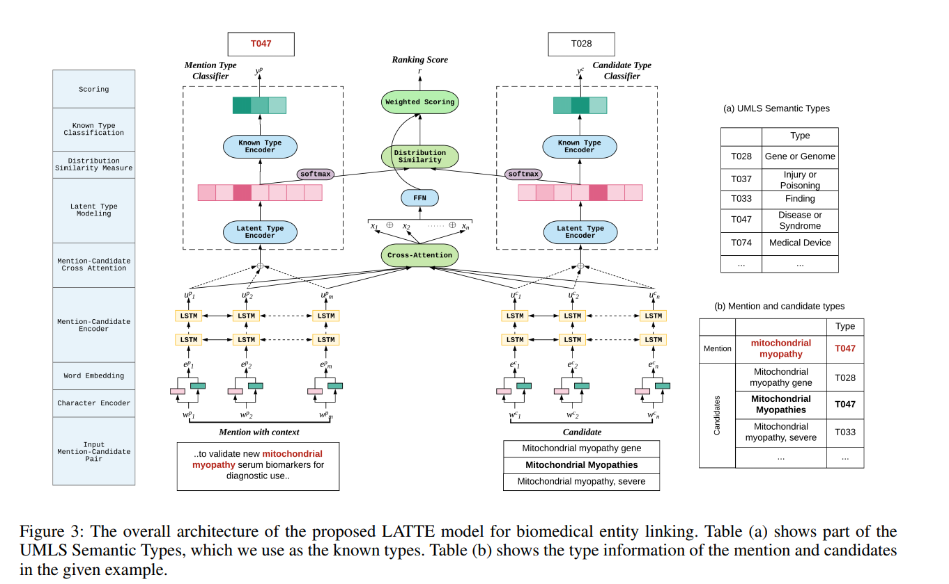
Model

Slide 8
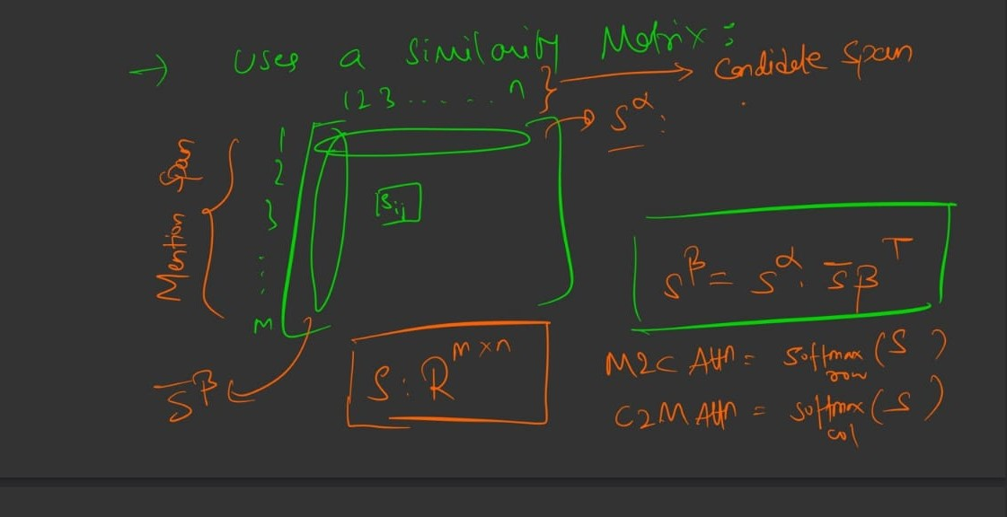
Cross Attn Layer

Slide 9
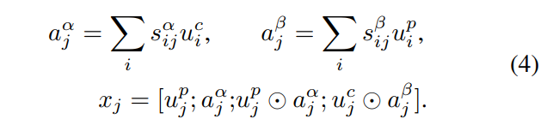



Similarity Score (f)
Attended vector are calculated as :
Vectors are concated :
X = [x1; ::; xn]
Fed into a multi-layer feed-forward network, to obtain the attention based relevance score ' f '

Slide 10
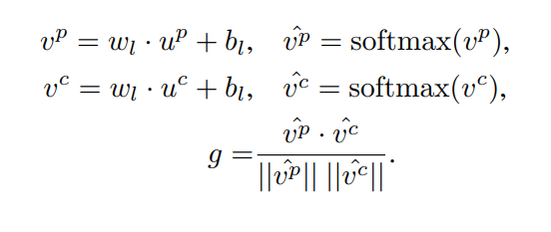
Latent Type (g)
This layer takes the output states of the encoder layer, and then concatenates them to form a fixed-dimensional vector u_{p} and u_{c}.
Passed through FFN -> softmax layer to obtain two probability distributions over 'k' latent types.
It then computes the similarity 'g' between the two distributions of the mention and the candidate using cosine similarity

Slide 11

Known Type Clf
The purpose of using KT clf is to indirectly supervise the latent type modelling, which is trained to predict the entity types of both the mention and candidate vectors.
It takes the encoded representations vp and vc of the latent types, and then uses a FFNk with ReLU activation .

Slide 12

Final Similarity Score
f -> interaction score
g -> latent type similarity

Slide 13

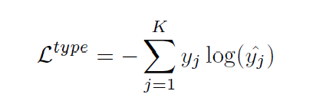
Losses optimization
Given the known type y belong to , of a mention or a candidate, and its predicted type distribution ycap, the loss is calculated as follows:
Type classification loss -

Slide 14


Ranking loss
Given the final scores of p with res to c(pos) and c(neg) respectively , the ranking loss is given by :

Slide 15
Modules and their importance
LT module - latent type encoder, Softmax & similarity measure. From this step, character embedding is included and the mention candidate interaction is switched to cross-attention.
KT module -This module consists of the two known type classifiers, for mention and candidate respectively

Slide 16
Binary Pairwise Relation Constraint
If one candidate is the ground truth entity for a given mention, the relation between them is labeled as 1, otherwise 0.
We can learn the latent types from this pairwise information, as a mention and its ground truth candidate should share the same latent type distribution.

Slide 17
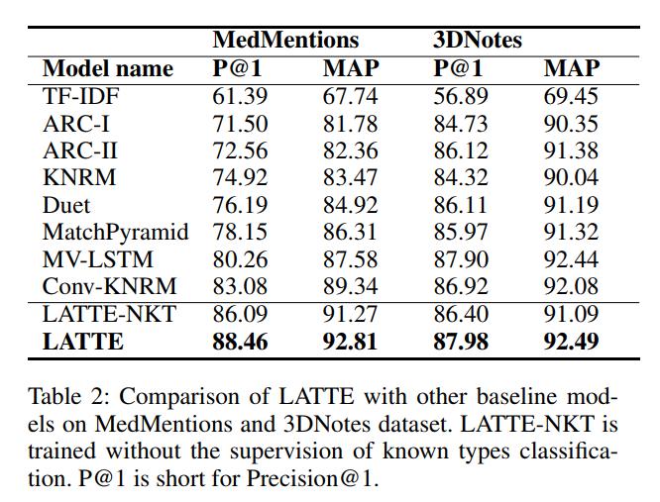
Result

Slide 18
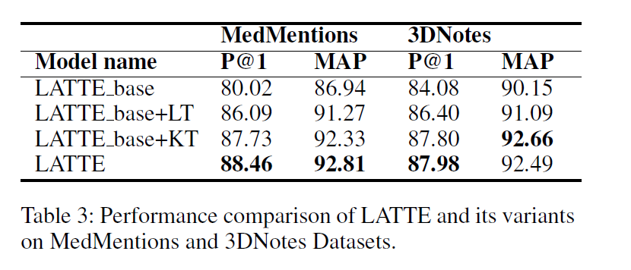
Effect of different components on model

Slide 19
Observation -LTM
Introducing latent type modeling with cross-attention boosts Precision@1 on MedMentions and 3DNotes by 6.07% and 2.32% respectively.
It shows that the cross-attention mechanism captures the semantic similarity between mention and candidates .
LATTE performs with a better margin on Med-Mentions than 3D notes due to its latent type matching feature being more effective for OOV words mentions.

Slide 20
Continued..
When the OOV rate is high, Type information provides an extra link between a mention and the corresponding entity, which is beyond lexical and semantic matching .
For such biomedical terms, we do not have pre-trained word embeddings.

Slide 21
Continued..
For abbreviations has very few common features with the complete name.
Also lower frequency, and hence it is hard for models to learn the mapping through training.
LATTE overcomes this problem by exploiting the type information .
Since each type has a large amount of samples to train the type classifiers.

Slide 22
Observation- KT clf
If we add the known type supervision(Type classifier), there are 7.71% and 3.72% gains in Precision@1 with respect to the two datasets.
This shows that multi-tasking with known type classification has strong positive effect on the entity linking task.

Slide 23
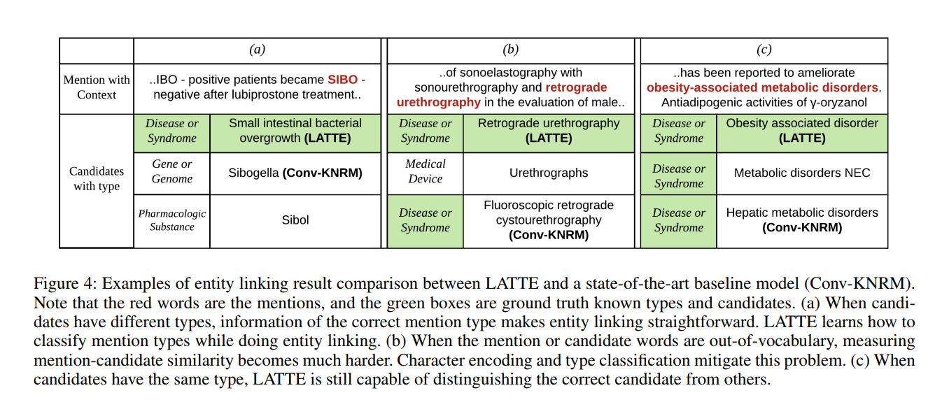
Problems Overcome

Slide 24
The End

